Slide 1

Image Processing and Computer Vision TMC 303
Dr. Nisha Chandran S.
Associate Professor
School of Computing

Slide 2
Lecture 1 Introduction

Slide 3
Digital Image
Image: Defines various aspects of the world
Contains a lot of crucial information
Can be represented as a 2D or 3D function
Digital Image: an image composed of Picture Elements (pixels)
Pixels are finite quantities of numeric representation of the intensity or gray level

Slide 4
Digital Image
Represented as a 2D function f(x,y) where x and y are the spatial coordinates
The amplitude of f at any position (x,y) is called the intensity or the gray level of the image at that point.
When x and y, the value of f are all discrete or finite values we call the image a digital image.
Notes:
Resolution: How many pixels are displayed per inch of an image
Higher resolution : more pixels per inch (ppi),more pixel information, High quality,crisp image
Low resolution: fewer pixels per inch,less information

Slide 5
Image as a 2D function
f (x,y) =r(x,y)*I(x,y)
r = reflectivity at x,y
I= intensity at x,y
X and y can take any values between max and min
f(x,y) can take any values between I_{max} and I_{min}
Notes:
Resolution: How many pixels are displayed per inch of an image
Higher resolution : more pixels per inch (ppi),more pixel information, High quality,crisp image
Low resolution: fewer pixels per inch,less information

Slide 6
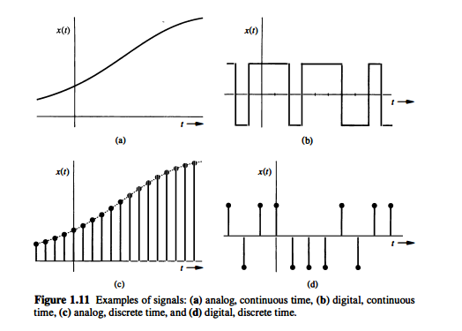
Why digitize an image?
Notes:
Resolution: How many pixels are displayed per inch of an image
Higher resolution : more pixels per inch (ppi),more pixel information, High quality,crisp image
Low resolution: fewer pixels per inch,less information

Slide 7
Digital Image
Resolution: How many pixels are displayed per inch of an image
Higher resolution : more pixels per inch (ppi), more pixel information, High quality, crisp image
Low resolution: fewer pixels per inch, less information
200x200
100x100
50x50
25x25

Slide 8
Where do digital images come from?
Digital cameras:
Charged with Charged Coupled Device (CCD) arrays
Also called image sensors
Contain metal oxide semiconductor capacitors which get charged proportional to the light intensity at that location
Visible light from an object falls through the lens of the digital camera to the CCD array and the image get captured

Slide 9
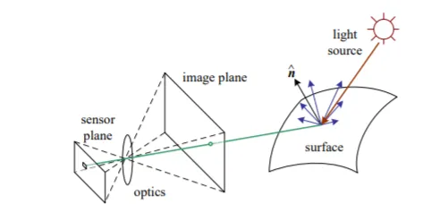
Image formation
Photometric Image Formation (Image credit: Szeliski, Computer Vision: Algorithms and Applications 2010)

Slide 10
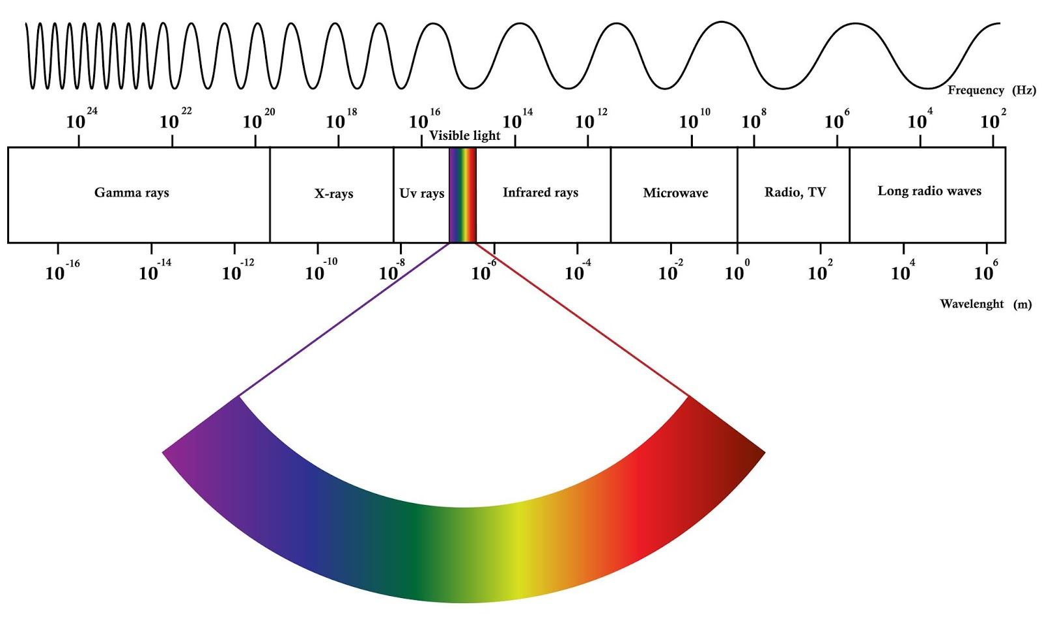
Electromagnetic Spectrum
Humans perceive limited band of the EM spectrum ‘the visible light’
Imaging machines perceive any range of the EM spectrum
Operate on images captured at any range
Ultrasound images, electron microscope images, computer generated images etc are all digital images

Slide 11
What is Digital Image Processing
Processing digital images using a computer
Why do you want to process an image?
To extract information (features) from them
Features used for further analysis and decision making
An important part of computer vision

Slide 12
Acquire an image
Correct aperture and color balance
Reconstruct image from projections
Prepare for display or printing
Adjust Image size
Color mapping, Gamma Correction, Halftoning
Facilitate picture storage and transmission
Efficiently store an image
Send an image from space

Slide 13
Enhance and restore images
Touch up personal photos
Colour enhancement
Extract information from images
Read bar codes
Character extraction

Slide 14
Computer Vision
Branch of Artificial Intelligence
Goal: use computer to
Emulate or replicate human vision
Learn
Make inferences
Act based on the visual inputs
Important for many real-world applications like robotics, object detection, Pattern recognition, AI applications etc.
Enables computers to identify and process objects in images and videos in the same way that humans do

Slide 15
Computer Vision
Pattern recognition
Train a computer to understand visual data
Feed it images, lots of image's thousands, millions if possible that have been labeled
Computer identifies the patterns in all the elements that relate to those labels.

Slide 16
Relation between Image processing
and Computer Vision
Image Processing
Image Analysis or Image Understanding
Computer Vision

Slide 17

3 types of processing can be done on images
Low level processing:
Primitive operations like removing noise, contrast enhancement,
image sharpening etc.
Both input and output of the process are images
Mid-level processing:
Segmentation
Description of objects in an image
Classification or recognition of objects in an image
Input is an image
Output will be features extracted from the image (edges,labels of individual objects etc)

Slide 18
High level processing:
Making sense of the information extracted from the image
Image analysis, image understanding
Perform the cognitive function normally associated with the vision
e.g: Automated analysis of text
Acquire the image of the area containing the text
Preprocess the image to extract the individual characters of the text
Describe the characters in a form suitable for computer processing
Recognize those characters
Make sense of the content
Steps 1 to 4 falls in digital image processing and step 5 is part of computer vision

Slide 19
Earliest Applications
Newspaper industry: pictures send through submarine cables
Images coded through specialized technique before sending and then reconstructed at the receiving end.
Digital picture produced in 1921

Slide 20
Digital picture produced in 1922
Digital picture produced in 1929
All are digital images but not as result of some digital image processing done
Digital computers were not used for creating them
Modern computer in 1940s
Digital image processing started in 1960s

Slide 21
First Picture of the moon by Ranger 7 spacecraft in 1964
Marks for geometric correction

Slide 22
Gamma ray Imaging
Inject the patient with a radioactive isotope
that emits gamma rays

Slide 23
X-ray Imaging

Slide 24
CT Scan
Uses X-rays

Slide 25
Ultraviolet Imaging
Normal corn and smut infected corn

Slide 26
Some interesting examples where image processing is used
Face detection
Face morphing
Face blurring for privacy protection
Visual code marker recognition
Painting recognition
CD cover recognition
Style transfer
Medicine
Space programs

Slide 27
Face detection
Face blurring for privacy protection

Slide 28
Visual code marker recognition

Slide 29
Painting recognition

Slide 30
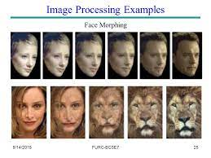

Slide 31
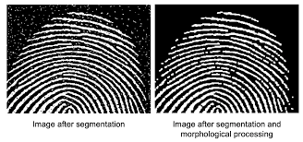

Slide 32
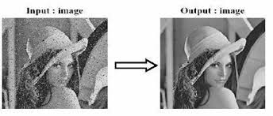

Slide 33
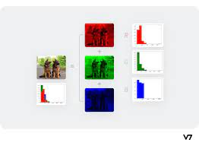

Slide 34
Image processing and related fields

